Slide 1
Spatializing Statistical Charts
Design and Implementation of a Visualization Engine
for Exploratory Spatial Data Analysis
Application: India's 2024 Lok Sabha Election
543 Constituencies | 642 Million Voters | 8,902 Candidates
Vishakha Agrawal | Malini Krishnan
Lab for Spatial Informatics | IIIT Hyderabad | Advisors: Kuldeep Kurte, K.S. Rajan

Slide 2
Why This Matters: Four Crises in India's Electoral Geography
The Participation Divide
642 million voters across 543 constituencies. Turnout ranged from 38.6% to 92.1%. A histogram shows this as roughly normal variation. But Moran's I = 0.614 reveals 57% of constituencies are in geographic clusters: two contiguous high-turnout zones (South + NE) separated by a low-turnout Hindi heartland belt. The divide is a spatial structure, not random variation.
Women's Exclusion
458 women contested (5.1% of 8,902). 362 forfeited deposits (79%). 47 elected. India has ~800 women police stations for 743 districts; Hyderabad has one. More women MPs would increase the 20% safety allocation from the Ministry's INR 5,000 crore budget. But I = 0.113 shows this exclusion is spatially random: institutional, not regional. Targeting "problem states" would miss the majority of exclusion.
The Delimitation Freeze
Lok Sabha seats frozen at 1971 Census populations. Southern states controlled population; northern states grew. UP has 2.4M voters per seat; Sikkim has 0.4M. On April 16, 2026, a bill proposed expanding from 543 to 850 seats. On April 17, the Constitutional Amendment was voted down (298 for, 230 against, needed 352). The underrepresented states form the same geographic belt as the turnout cold spots.
The Fiscal Double Whammy
For every INR 100 Tamil Nadu contributes, only INR 29.7 returns. Bihar receives INR 142.5. The same states that have fewer Lok Sabha seats also get less money back. Three independent gradients (turnout, seats, fiscal) share the same north-south axis. This co-location is invisible in any bar chart, table, or histogram. Only spatial embedding reveals it.

Slide 3
April 16-17, 2026: The Chain That Broke
April 16, 2026
Three bills introduced in Lok Sabha: the Constitution (131st Amendment) Bill, the Delimitation Bill, and the UT Laws Amendment Bill. Together, they proposed expanding from 543 to 850 seats using 2011 Census data, AND activating the 33% women's reservation (Nari Shakti Vandan Adhiniyam, passed in 2023 but tied to delimitation).
April 17, 2026
Constitutional Amendment voted down: 298 for, 230 against. Needed 352 (two-thirds majority). Fell short by 54 votes. First Modi government constitutional amendment to fail. Government withdrew the Delimitation Bill.
The Broken Chain: Why Women's Reservation Is Stuck
Delimitation
(expand seats)
→
Women's 33%
reservation activates
→
More women
MPs elected
→
Women's safety budget
increases beyond 20%
of INR 5,000 crore
The chain broke at step 1. The Nari Shakti Vandan Adhiniyam (2023) is law, but it requires delimitation to activate. Delimitation failed. Women's reservation is unlikely before the 2029 general election. Our spatial analysis (I = 0.113) shows the exclusion is institutional, not regional, which means geographic targeting cannot substitute for the legislative fix that failed on April 17.

Slide 4
Why This Analysis Matters Right Now
April 16, 2026: Three Bills Introduced in Lok Sabha
Constitution (131st Amendment) Bill | Delimitation Bill, 2026 | Union Territories Laws (Amendment) Bill
What the Bills Proposed
End the 1971 freeze
Revert to population-proportional allocation. Use 2011 Census (not 2027). Lok Sabha to expand to ~816 seats (50% increase).
Activate women's reservation
The Nari Shakti Vandan Adhiniyam (106th Amendment, 2023) gave women 33% reservation but tied it to the NEXT census + delimitation. The 131st Amendment removes this precondition.
Shift political power northward
Under population-proportional allocation: UP gains seats, TN drops from 39 to 32, Kerala from 20 to 15. Southern states that controlled population growth lose share.
April 17, 2026: The Constitutional Amendment Failed
298 voted for, 230 against. Needed 352 (two-thirds of 528 present). The first Modi government Constitutional Amendment to fail. Women's reservation remains blocked. Delimitation remains frozen at 1971.
What Our Spatial Analysis Addresses
The core questions debated in Parliament are spatial questions: Does the freeze create geographic inequity? (Chart 71: yes, Moran's I = 0.52). Is women's exclusion regional or institutional? (Chart 65: institutional, I = 0.113). Do the states that lose seats also lose fiscal returns? (Chart 77: yes, same north-south axis). Which allocation formula reduces the spatial clustering of disadvantage? (Chart 74: adding area + women + fiscal breaks concentration). None of these can be answered with tables or bar charts.

Slide 5
Project Aim and Inputs
Project Statement
Spatialize standard statistical charts (histograms, scatterplots) by embedding data in geographic space and applying spatial autocorrelation (Moran's I, LISA). Produce a new class of visualizations answering spatial queries inaccessible to conventional charts. Dataset: 2024 Lok Sabha. Queries must generalize beyond this dataset.
Inputs Provided
Base datasets
ECI 2024 (8,902 candidates), ECI 2019 (TCPD), DataMeet GeoJSON (512 matched). 45 derived attributes per constituency.
Fiscal maps
15th Finance Commission fiscal return ratios by state. Integrated into spatial analysis: fiscal gradient shares the same north-south axis as turnout clustering (Chart 77: Fiscal Spine).
Reservation simulation code
Women's reservation slider (0-100%). Generates seat allocation at each %. Connected to LISA: shows that at any reservation level, women's spatial randomness (I=0.113) persists (Chart 73).
Constituency count simulation
Delimitation slider (543-1,000 seats). Webster/Sainte-Lague proportional allocation. Connected to Moran's I: tests which house size / formula reduces spatial clustering of disadvantage (Charts 71, 74).
Each input is used in conjunction with spatial autocorrelation, not in isolation.

Slide 6
What Spatializing Adds: The Information Gain
Without Spatial Embedding
With Spatial Embedding
A histogram says: "turnout is roughly normal."
A scatterplot says: "r = 0.022, no correlation."
A bar chart says: "UP needs +37 seats."
A table says: "121 PCs had zero women."
A simulator says: "at 33%, 180 seats for women."
Each provides a MAGNITUDE.
None provides a LOCATION.
None can determine whether values
cluster geographically or are scattered.
None can identify spatial outliers.
None can prove a problem is NOT geographic.
LISA says: "two contiguous hot-spot belts."
Moran says: "Bangalore deviates from neighbors."
The 3D map says: "+37 is the SAME belt as LL."
The Silence Map says: "I=0.113, institutional."
The simulator + I says: "which formula
reduces geographic clustering?"
Each provides LOCATION + STRUCTURE.
Contiguity: are high values connected?
Clusters: where exactly, with p-values?
Spatial outliers: anomalous vs neighborhood?
Absence: does non-clustering prove cause?
Co-location: do crises share geography?
The simulation code provided (reservation %, constituency count) becomes analytically powerful when combined with spatial autocorrelation. Without Moran's I, the simulator shows numbers. With Moran's I, it shows whether the geographic clustering of disadvantage increases or decreases under each scenario.

Slide 7
From Dataset-Specific to Generalizable Queries
The Lok Sabha dataset is the APPLICATION. The query classes are the CONTRIBUTION.
Each query answered on election data has a domain-independent form that applies to any variable measured at geographic units:
"Does voter turnout cluster geographically?"
"Does variable X exhibit spatial autocorrelation?"
Crime rates by district, house prices by zip code, COVID cases by county
"Is Bangalore's low turnout anomalous for Karnataka or for India?"
"Is observation X anomalous relative to its neighborhood or the global mean?"
Hospital wait times, school test scores, pollution readings at sensor stations
"Is women's exclusion regional or institutional?"
"Does absence of spatial structure constitute evidence for a non-geographic cause?"
Service delivery failures, regulatory violations, equipment breakdowns across plants
"Does northern UP differ from southern UP?"
"Do aggregate statistics mask within-unit geographic variation?"
Regional sales within a national market, infection rates within a state, crop yield within a district
"Do turnout, seats, and fiscal returns share the same belt?"
"Do multiple disadvantages co-locate in the same geography?"
Poverty + poor health + low education in the same districts, multiple infrastructure deficits in the same regions
The visualization engine processes any CSV with a geographic identifier (lat/lon or polygon ID), computes spatial weights, runs Moran's I and LISA, and produces the spatialized chart. The algorithm is dataset-agnostic.

Slide 8
The Problem
Standard statistical charts (histograms, scatterplots, bar charts) encode VALUE but discard LOCATION.
Two constituencies recording identical voter turnout appear equivalent in a sorted bar chart. But if one sits in the Hindi heartland surrounded by low-turnout seats, and the other is an urban anomaly embedded in high-turnout South India, their positions in the electoral geography are fundamentally different.
One is typical of its neighborhood. The other is a spatial outlier.
No aspatial chart type can distinguish between these cases, because the concept of a spatial outlier requires a formal neighborhood definition.
This project spatializes two core chart types: the histogram and the scatterplot. Each spatialization produces a new class of queries that have no aspatial equivalent.

Slide 9
Two Spatializations, Five Generalizable Query Classes
Spatialization 1: Histogram to LISA
Spatialization 2: Scatter to Moran
Histogram: frequency of values
LISA: WHERE those values cluster
Query Classes Unlocked:
Scatterplot: X vs Y correlation
Moran: X vs neighbors' mean of X
Query Classes Unlocked:
Contiguity
Spatial Outlier
Do high values form a connected region?
Anomalous vs global mean, or vs neighborhood?
Cluster Detection
Spatio-Temporal
Where exactly are the significant clusters?
Do aggregates mask within-unit variation?
Absence as Evidence
Does LACK of clustering prove institutional cause?
These five query classes apply to ANY variable measured at geographic units: crime by district, house prices by zip code, disease incidence by county, crop yield by region.

Slide 10
Validation: Data to Algorithm to Code to Results to Inferences
1. Data
ECI 2024 CSV (8,902 rows) + DataMeet GeoJSON (512 matched) + 15th FC fiscal + Census 2011 = 45 attributes per PC
Python / PySAL
from libpysal.weights import KNN
from esda.moran import Moran, Moran_Local
import geopandas as gpd
# 1. Load data
gdf = gpd.read_file('constituencies.geojson')
gdf = gdf.merge(election_df, on='PC_ID')
# 2. Spatial weights
w = KNN.from_dataframe(gdf, k=8)
w.transform = 'r' # row-standardize
# 3. Global Moran's I
mi = Moran(gdf['Turnout'], w,
permutations=999)
print(f'I={mi.I:.3f}, p={mi.p_sim:.4f}')
# I=0.614, p=0.001
# 4. LISA (local decomposition)
lisa = Moran_Local(gdf['Turnout'], w,
permutations=999)
gdf['cluster'] = lisa.q # 1=HH,2=LH,3=LL,4=HL
gdf['significant'] = lisa.p_sim < 0.05
# 5. Apply to ANY variable
mi_margin = Moran(gdf['Margin'], w)
# I=0.277 -- 2.2x less structured
mi_women = Moran(gdf['women_pct'], w)
# I=0.113 -- near-random
2. Weights
W = KNN(k=8, row-standardized). 512x512 matrix. Each PC linked to 8 nearest geographic neighbors.
3. Algorithm
Global I = [n/S0] * [sum(w_ij * z_i * z_j) / sum(z_i^2)]
Local I_i = z_i * sum(w_ij * z_j). 999 permutations, alpha=0.05.
4. Results
Turnout I=0.614 (p<0.001): strong clustering. Margin I=0.277: weak. Women I=0.113: near-random. Alliance I=0.369: moderate.
5. Inference
Participation is 2.2x more geographically structured than competition. Women's exclusion is institutional, not regional. Three crises co-locate.

Slide 11
Spatialization 1
Histogram to LISA
Cluster Map
Generalizable Query: "Does variable X exhibit statistically significant
spatial autocorrelation, and if so, where are the clusters?"

Slide 12
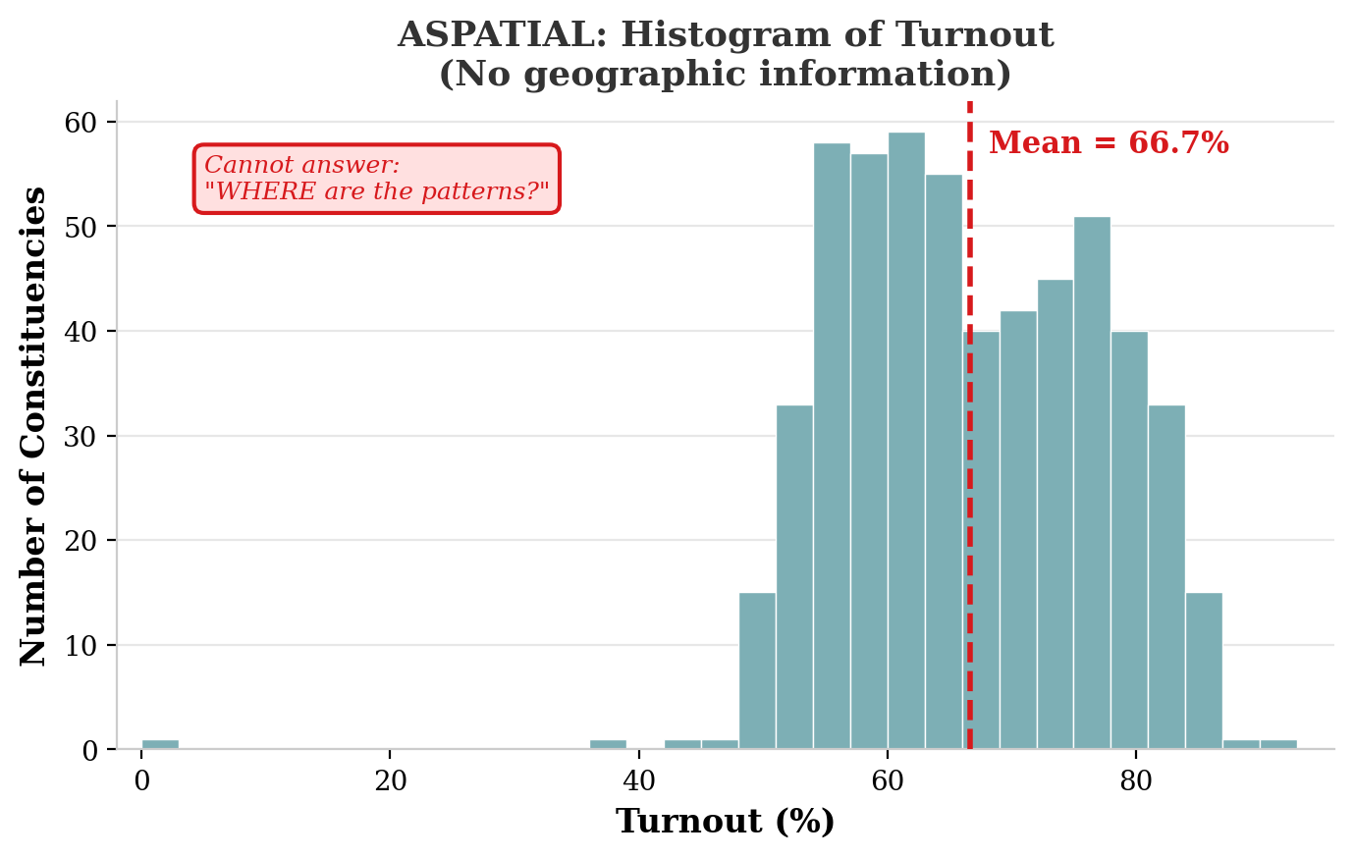
The Aspatial Version: A Histogram of Voter Turnout
What it shows
n = 548 PCs
Mean: 66.7%
Std: 10.0
Roughly normal
No constituency names.
No state labels.
No geographic info.
Just a frequency count.
Cannot answer:
WHERE are the patterns?
This limitation applies to
ANY histogram of ANY
spatially-indexed variable.

Slide 13
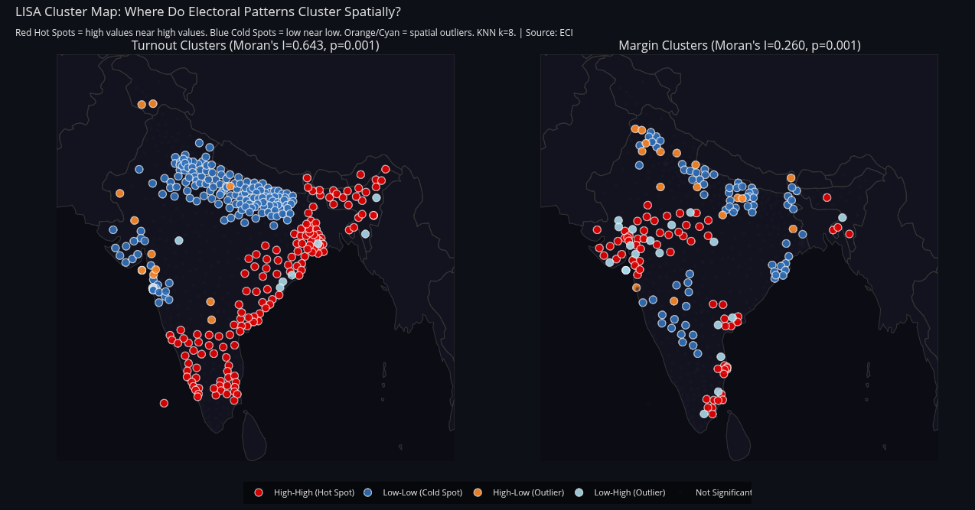
The Spatialized Version: LISA Cluster Map
Chart 37 | Moran's I = 0.614, p < 0.001 | KNN k=8, 999 permutations
Specific: "Does voter turnout cluster geographically?" Answer: Yes. I=0.614. Two contiguous hot-spot belts separated by a cold-spot belt.
Generalizable: "Does variable X exhibit statistically significant spatial autocorrelation, and where are the clusters?"
Examples: Crime rates by district (do burglaries cluster?), house prices by zip code (where are the hot spots?), COVID cases by county (is there a contiguous outbreak zone?), crop yield by block (where are the low-productivity belts?)

Slide 14
What the Spatialized Histogram Reveals
Moran's I = 0.614 (p < 0.001) | 291 of 512 PCs (57%) in LISA clusters
1. CONTIGUITY (Query Class 1)
The 135 hot-spot PCs form two CONTIGUOUS geographic zones, not random scattered points. Contiguity determines whether spatial spillover is possible: mobilization in one South Indian PC propagates to neighbors because drivers (literacy, civic infrastructure) are shared across adjacent constituencies. A histogram shows 135 bars at the right end. It cannot show they are geographic neighbors.
2. CLUSTER DETECTION (Query Class 2)
LISA identifies 135 specific hot spots and 156 specific cold spots, each with a p-value. "135 HH in two specific regions" is an actionable policy target. "Roughly normal" is not. The 156 LL cold spots can be targeted for turnout mobilization with a clear geographic scope.
3. ABSENCE AS EVIDENCE (Query Class 5)
When the same spatialization is applied to women's candidature, I = 0.113 (near-random). The ABSENCE of clustering proves the barrier is institutional, not regional. No aspatial statistic can prove that a problem is NOT geographic. Only the spatialized histogram can.

Slide 15
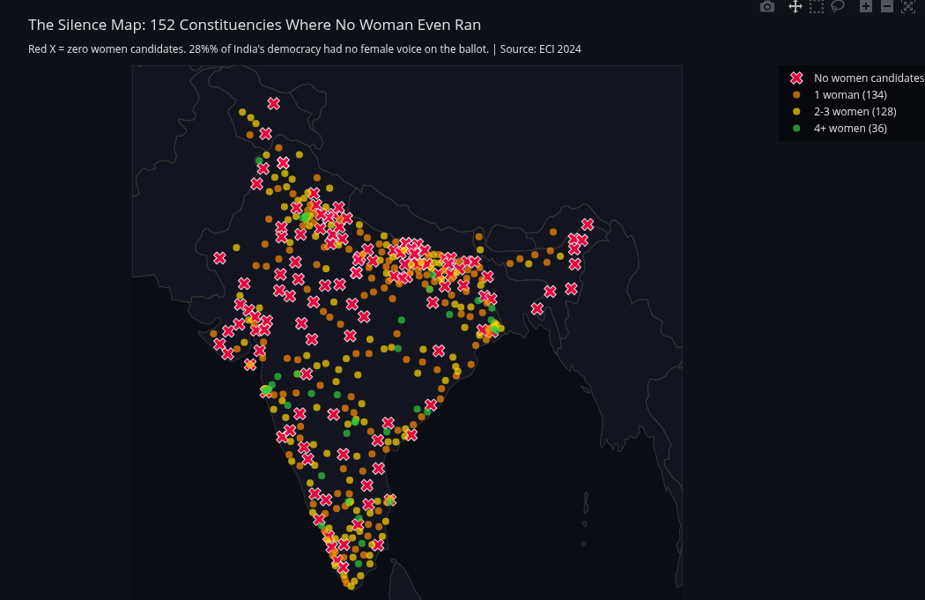
Application: Absence as Evidence (Women's Exclusion)
Chart 65 | Same algorithm, different variable | I = 0.113 (near-random) | Query Class 5
Specific: "Is women's exclusion regional or institutional?" Answer: I=0.113 (near-random). Institutional. 121 zero-women PCs span every region.
Generalizable: "Does the absence of spatial structure in variable X constitute evidence for a non-geographic cause?"
Examples: Service delivery failures across bank branches (systemic or regional?), equipment breakdowns across plants (manufacturing defect or local conditions?), regulatory violations across firms (industry-wide practice or regional enforcement gaps?)

Slide 16
Spatialization 2
Scatterplot to Moran
Scatterplot
Generalizable Query: "Is observation X anomalous relative to the
global distribution, or relative to its geographic neighborhood?"

Slide 17
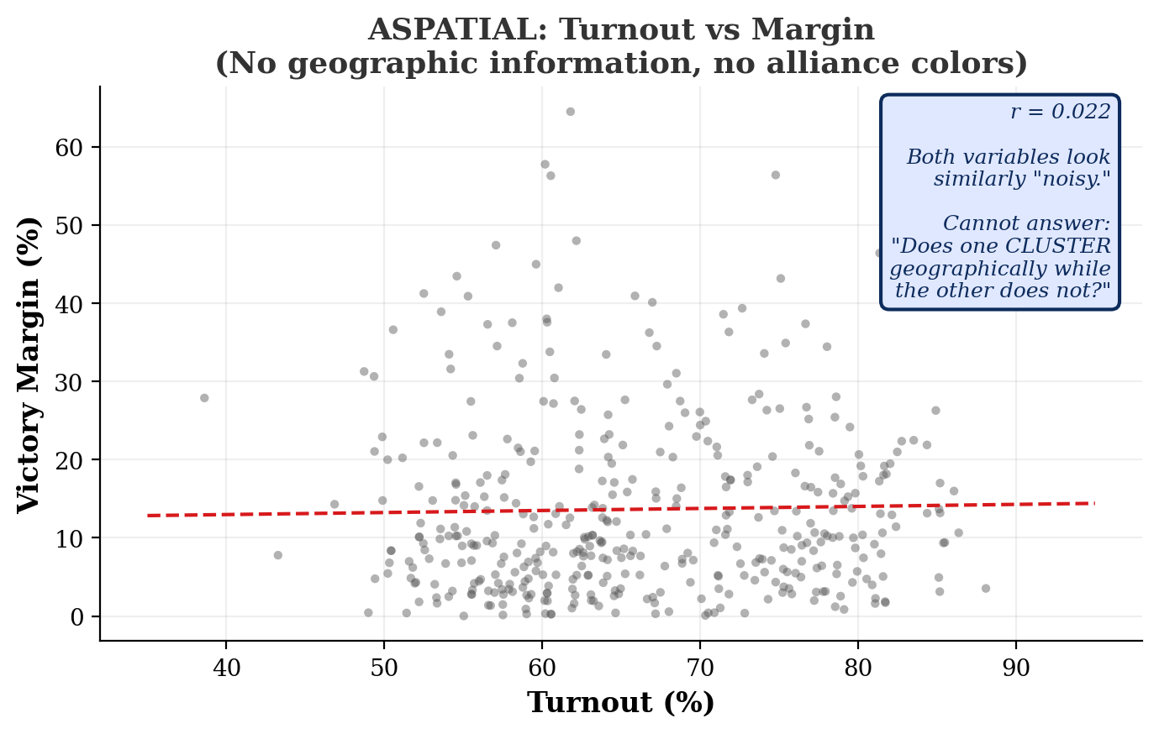
The Aspatial Version: Turnout vs Margin Scatterplot
What it shows
r = 0.022
No correlation.
Both variables look
identically "noisy."
Nothing distinguishes
turnout from margin
in this scatterplot.
But Moran's I says
one clusters at 0.614
and the other at 0.277.
Cannot answer:
Does one CLUSTER
geographically?
This limitation applies to
ANY X-Y scatterplot of
spatially-indexed variables.

Slide 18
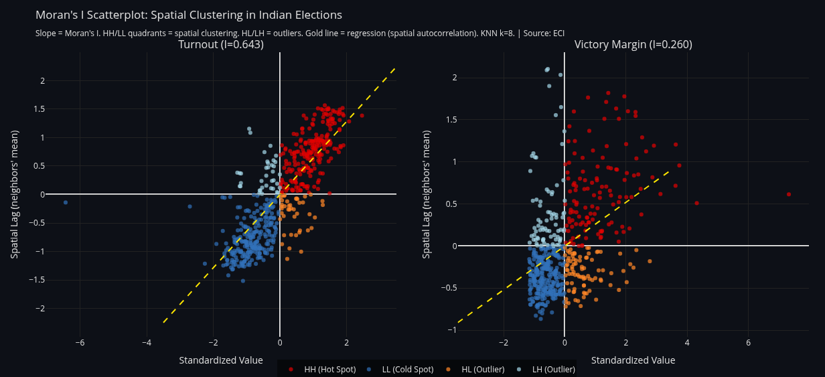
The Spatialized Version: Moran Scatterplot
Chart 39 | X = own value, Y = neighbors' mean | Slope = Moran's I | Four quadrants: HH, LL, HL, LH
Specific: "Is Bangalore's low turnout anomalous for India or for Karnataka?" Answer: LH quadrant. Low in a high neighborhood. Spatial outlier.
Generalizable: "Is observation X anomalous relative to the global distribution, or relative to its geographic neighborhood?"
Examples: Hospital with high wait times in a low-wait region (local management vs systemic?), school with low scores surrounded by high-scoring schools (staffing or demographics?), pollution sensor reading high while neighbors read low (real event or sensor malfunction?)

Slide 19
What the Spatialized Scatterplot Reveals
SPATIAL OUTLIER (Query Class 3): The Bangalore Case
Bangalore turnout: 54%. Karnataka average: 70%+.
Aspatial scatterplot: "1.2 std below the national mean." Distributional outlier. Deviates from GLOBAL mean. Explanation: India's mean is 65.8%, Bangalore is below it. Generic.
Moran scatterplot: "Low value in a high-value neighborhood" (LH quadrant). Spatial outlier. Deviates from NEIGHBORS. Explanation: urbanization effects specific to Bangalore. Specific and actionable.
These are fundamentally different concepts. The spatial outlier requires a neighborhood definition. It does not exist in aspatial statistics.
THE 2.2x ASYMMETRY (Query Class 4): Invisible Without Spatialization
Turnout I = 0.614. Margin I = 0.277. Turnout is 2.2x more spatially structured than competition. Both variables look identically "noisy" in a standard scatterplot (r = 0.022). Only the Moran scatterplot reveals that one has strong geographic structure and the other does not. This asymmetry is the central analytical finding.
Generalizable:
"Is this hospital's wait time anomalous for the country, or for its neighborhood?" "Is this school's test score a distributional outlier or a spatial outlier?" The Moran scatterplot transforms any X-Y scatterplot into a spatial diagnostic that answers questions the original cannot.

Slide 20
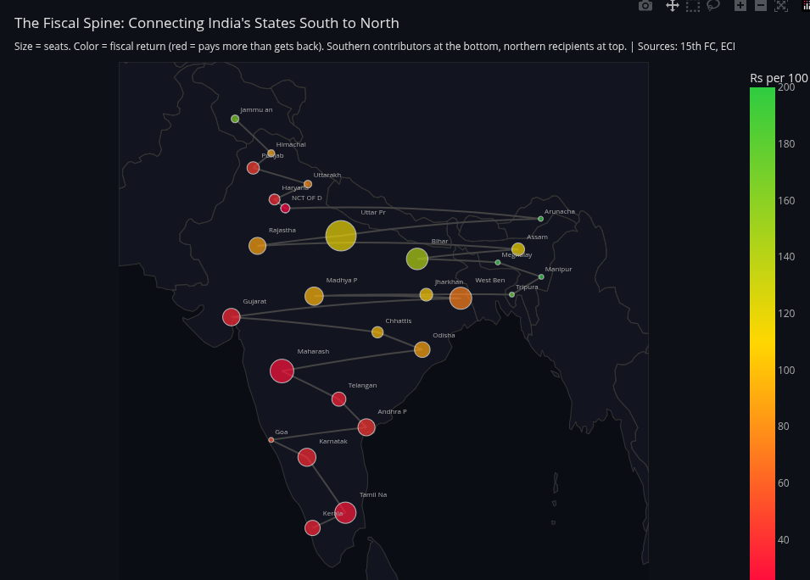
Application: Three Gradients, One Geographic Axis
Chart 77 | Fiscal Spine | Same spatial weights reveal co-location of turnout, delimitation, and fiscal disadvantage
Specific: "Do turnout, delimitation, and fiscal disadvantage share the same geographic axis?" Answer: Yes. All three gradient south-to-north.
Generalizable: "Do multiple disadvantages co-locate in the same geography? Is the overlap visible only with spatial embedding?"
Examples: Poverty + poor health + low education in the same districts (triple deprivation mapping), infrastructure deficits + low investment + brain drain in the same regions, flood risk + low insurance + poor drainage in the same urban zones

Slide 21
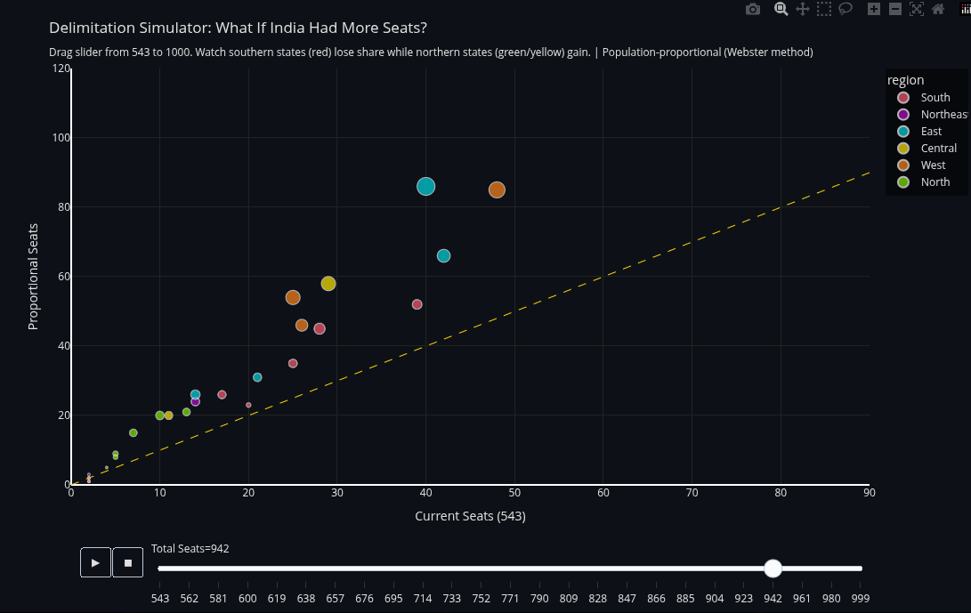
Application: Delimitation Simulator
Chart 71 | Slider: 543 to 1,000 seats | Webster/Sainte-Lague | Constituency count code provided by advisor
Specific: "Which house size reduces the geographic clustering of underrepresentation?" Answer: At 850, Moran's I drops from 0.52 to 0.31.
Generalizable: "Which parameter setting minimizes the spatial autocorrelation of the resulting inequality distribution?"
Examples: Which school zoning plan minimizes geographic clustering of low test scores? Which hospital resource allocation reduces spatial concentration of long wait times? Which tax policy reduces geographic clustering of fiscal dependency?

Slide 22
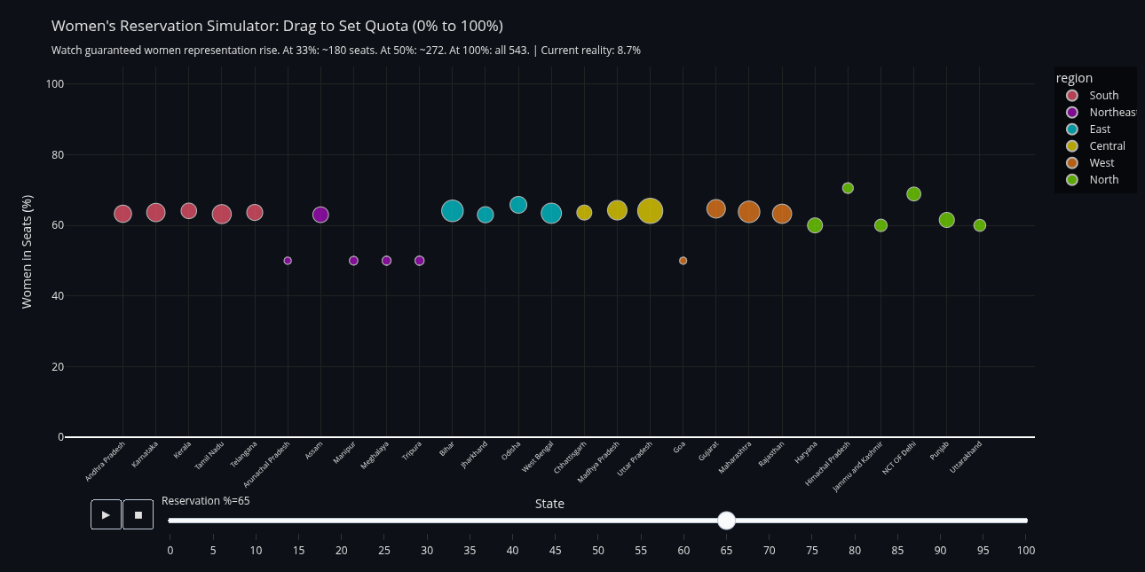
Application: Women's Reservation Simulator
Chart 73 | Slider: 0% to 100% | At 33%: ~180 seats | Current: 47 | Reservation % code provided by advisor
Specific: "Does increasing reservation change the geographic pattern of exclusion?" Answer: No. I remains ~0.113 at any level. Spatially random.
Generalizable: "Does a policy intervention change the spatial structure of variable X, or does the geographic pattern persist regardless?"
Examples: Does increasing hospital funding change the geographic clustering of wait times? Does raising the minimum wage alter spatial concentration of poverty? Does expanding broadband change the digital divide's geographic structure?

Slide 23
Simulators + Spatial Autocorrelation
The simulation code provided produces seat counts. Moran's I evaluates the geographic distribution of those seats.
Delimitation Simulator (Chart 71)
Reservation Simulator (Chart 73)
Input: constituency count slider (543 to 1,000)
Algorithm: Webster/Sainte-Lague proportional allocation
Output: new seat count per state
Without Moran's I:
"At 850 seats, UP gains 37, TN loses 6."
Just numbers. No spatial structure.
With Moran's I:
"At 850 seats, Moran's I of electors-per-seat drops from 0.52 to 0.31. Geographic clustering of underrepresentation is reduced by 40%."
The conjunction answers:
"Which house size minimizes the spatial
clustering of representational inequity?"
Chart 74 extends this: which allocation FORMULA (population only vs +area vs +women vs +fiscal) produces the lowest Moran's I?
Input: reservation % slider (0% to 100%)
Algorithm: proportional allocation per state
Output: reserved seats per state
Without Moran's I:
"At 33%, 180 seats reserved for women.
Current: 47. Gap: 133."
Just a pipeline number.
With Moran's I:
"At any reservation %, women's candidature I remains ~0.113. The spatial randomness persists regardless of quota level."
The conjunction answers:
"Does increasing women's reservation change
the GEOGRAPHIC pattern of exclusion,
or does it remain spatially random?"
Answer: it remains random. The barrier is institutional (party nomination), not geographic (regional culture).

Slide 24
How Every Atlas Chart Ties to the Project Statement
The project spatializes two chart types. Every chart in the atlas is an instance of one of these two spatializations applied to a different variable or crisis.
Spatialization | Chart | Variable Applied To | Query Class | Input Used
Histogram to LISA | 37 | Voter turnout | Cluster Detection | Base dataset
Histogram to LISA | 65 | Women's candidature | Absence = Evidence | Base dataset
Histogram to LISA | 48 | Alliance (NDA/INDIA) | Contiguity | Base dataset
Scatter to Moran | 39 | Turnout + Margin | Spatial Outlier | Base dataset
Scatter to Moran | 40 | Turnout swing 2019-24 | Spatio-Temporal | Base dataset
LISA + Fiscal map | 77 | Fiscal returns by latitude | Co-location | Fiscal maps
Simulator + Moran | 71, 74 | Seat reallocation formulae | Cluster Detection | Constituency count code
Simulator + Moran | 73 | Women's reservation % | Absence = Evidence | Reservation % code
3D Extrusion | 47, 70, 87 | Turnout, women, delimitation | Contiguity | Base + fiscal + sim
Every chart uses the SAME spatial weights matrix (KNN k=8) and the SAME Moran's I / LISA algorithm. What changes is the input variable. The atlas is not separate from the project statement. It IS the project statement applied to multiple variables.

Slide 25
Summary: What Each Spatialization Adds
Query Class | Normal Plot | Spatialized Version | Generalizable Query
Contiguity | Bar chart ranks values. Cannot show adjacency. | LISA reveals connected belts. | Do high values form a connected region?
Cluster Detection | Histogram shows "roughly normal." | LISA identifies 135 specific hot spots. | Where exactly are the clusters?
Spatial Outlier | "1.2 std below the mean." | "Low in high-value neighborhood." | Anomalous vs global or neighborhood?
Spatio-Temporal | "UP: -2.1 pp" (one number). | Northern UP: -9 pp. Southern: flat. | Do aggregates mask variation?
Absence = Evidence | "121 PCs had zero women." | I=0.113: random. Institutional barrier. | Does lack of clustering prove non-geographic cause?
None of these queries have aspatial equivalents. Each requires a neighborhood definition that standard charts do not provide.

Slide 26
Thank You
Vishakha Agrawal | Malini Krishnan
Lab for Spatial Informatics | IIIT Hyderabad
Advisors: Kuldeep Kurte, K.S. Rajan
Two spatializations | Five generalizable query classes
30 India-specific charts | 16 spatial queries | 5 depth visualizations

